Slide 1
Pseudo Eye Simulations
Dmitry Vasilchenko Mar 2020

Slide 2
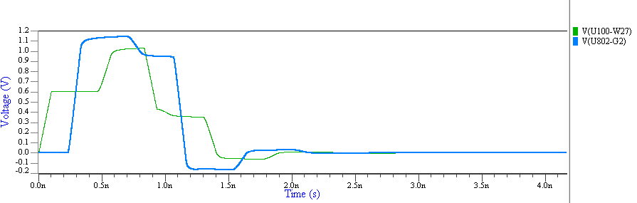
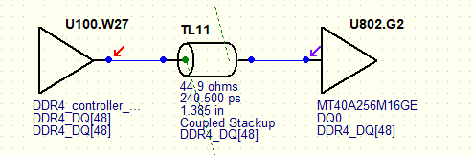
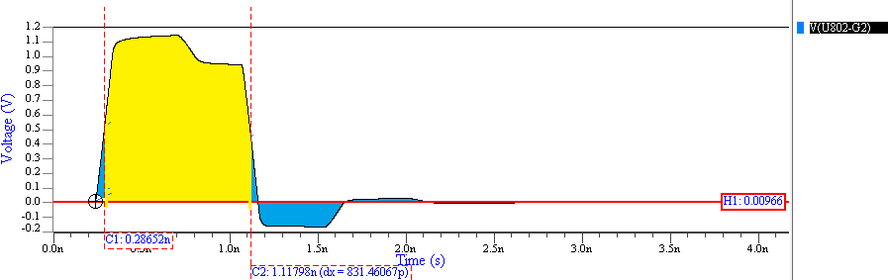
Pseudo Eye simulation
Net: DDR4_DQ[48] UI = 833ps Edge=100ps, Rx R=1000 Ohms
[INFO]Net DDR4_DQ[48]
[INFO]Simulation #1. ISI. Driver: U100.W27
[INFO] Receiver: U802.G2 Sig: 848.9 ISI: 103.4

Slide 3
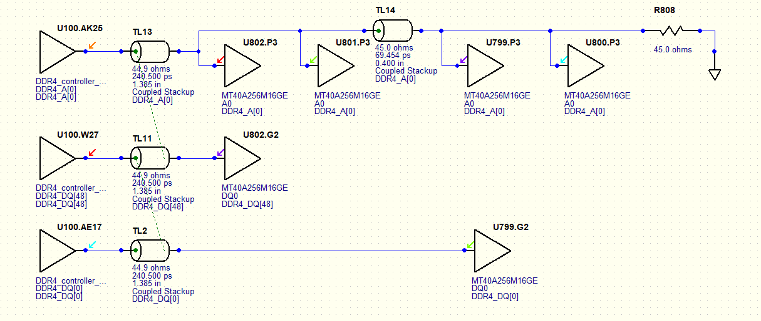
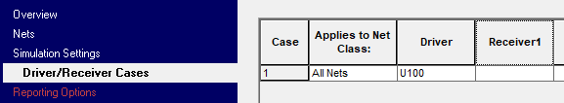
Victim DQ[48], Aggressors A[0], DQ[0]
INFO]Simulation #2. Crosstalk. Aggressor drivers: U100.AK25;U100.AE17
[INFO] Receiver: U802.G2 Crosstalk 9.0

Slide 4
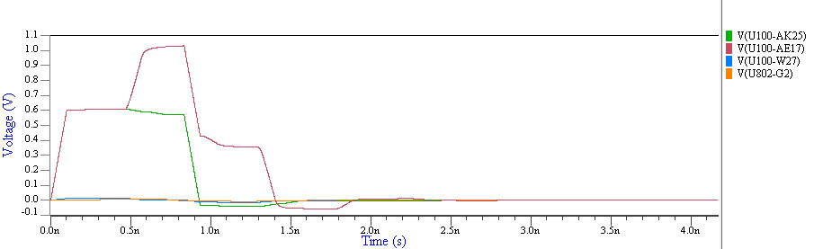
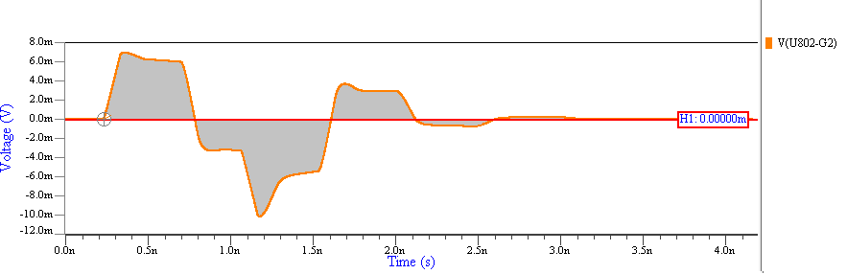
[INFO]Simulation #2. Crosstalk. Aggressor drivers: U100.AK25;U100.AE17
[INFO] Receiver: U802.G2 Crosstalk 9.0 (V*ps)

Slide 5
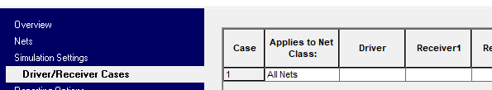
Round robin simulations for victim buffers
Output window
[INFO]Net DDR4_DQ[48]
[INFO]Simulation #1. ISI. Driver: U100.W27
[INFO] Receiver: U802.G2 Sig: 848.9 ISI: 103.4
[INFO]Simulation #2. Crosstalk. Aggressor drivers: U100.AK25; U100.AE17
[INFO] Receiver: U802.G2 Crosstalk 9.0
[INFO]Simulation #3. ISI. Driver: U802.G2
[INFO] Receiver: U100.W27 Sig: 848.9 ISI: 103.3
[INFO]Simulation #4. Crosstalk. Aggressor drivers: U100.AK25; U799.G2
[INFO] Receiver: U100.W27 Crosstalk 27.3
prpe.rpt
===========================================================================
Net Max Max Max Min Min
name SIG (V*ps) ISI(V*ps) Xtalk(V*ps) P-eye(V*ps) P-ratio
===========================================================================
DDR4_DQ[48] 848.87 103.35 27.29 718.25 6.50
detailed_prpe.csv
Net | Aggressor Drivers(s) | Driver(s) [RefDes.Pin] | Receiver [RefDes.Pin] | SIG (V*ps) | ISI (V*ps) | Xtalk (V*ps) | P-eye (V*ps) | P-ratio
DDR4_DQ[48] | U100.AK25; U100.AE17 | U100.W27 | U802.G2 | 848.866 | 103.354 | 8.963 | 736.548 | 7.558
DDR4_DQ[48] | U100.AK25; U799.G2 | U802.G2 | U100.W27 | 848.867 | 103.328 | 27.287 | 718.252 | 6.499

Slide 6
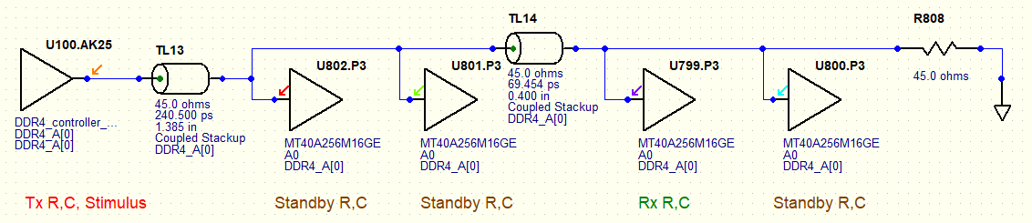
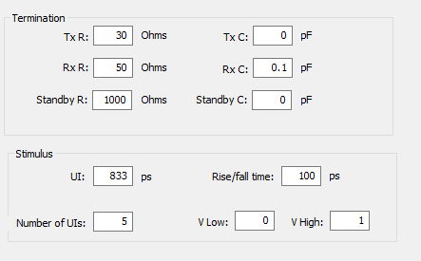

Termination configuration. TX=U100 RX=U799
[INFO]Net DDR4_A[0]
[INFO]Simulation #1. ISI. Driver: U100.AK25
[INFO] Receiver: U799.P3 Sig: 313.9 ISI: 35.9

Slide 7
Termination spice circuit
Spice circuit:
X_U100_AK25 U100_AK25 prpe_tx
X_U799_P3 U799_P3 prpe_rx
X_U800_P3 U800_P3 prpe_SB
X_U801_P3 U801_P3 prpe_SB
X_U802_P3 U802_PE prpe_SB
.subckt prpe_tx pin
R_R_tx 0 midNode 3.0000000e+01
V_prpe_voltage_source pin midNode PWL(..)
.subckt prpe_rx pin
C_C_rx 0 pin 1.0000000e-13
R_R_rx 0 pin 5.0000000e+01
.subckt prpe_SB pin
R_R_SB 0 pin 1.0000000e+03

Slide 8
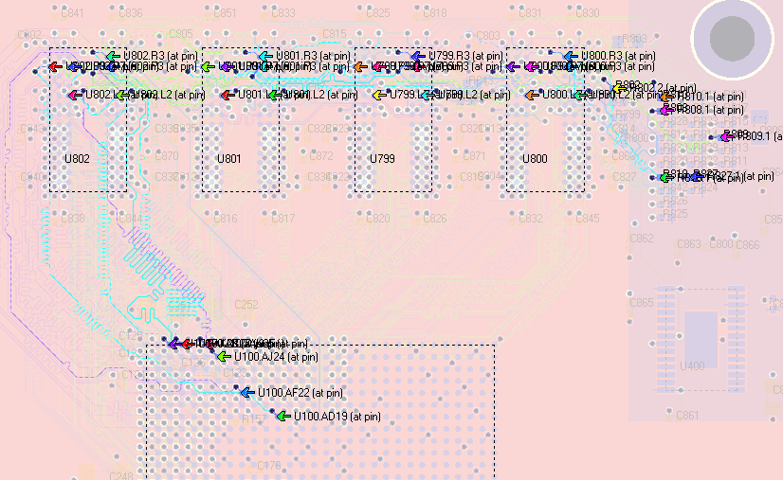
Electrical coupling thresholds
Threshold | Time, s | #Agg | Crosstalk, V*ps
150mV | 1 | 1 | 11
50mV | 6 | 3 | 26
10mV | 12 | 5 | 23.5
1mV | 23 | 5 | 23
0.5mV | 25 | 5 | 22.7

Slide 9
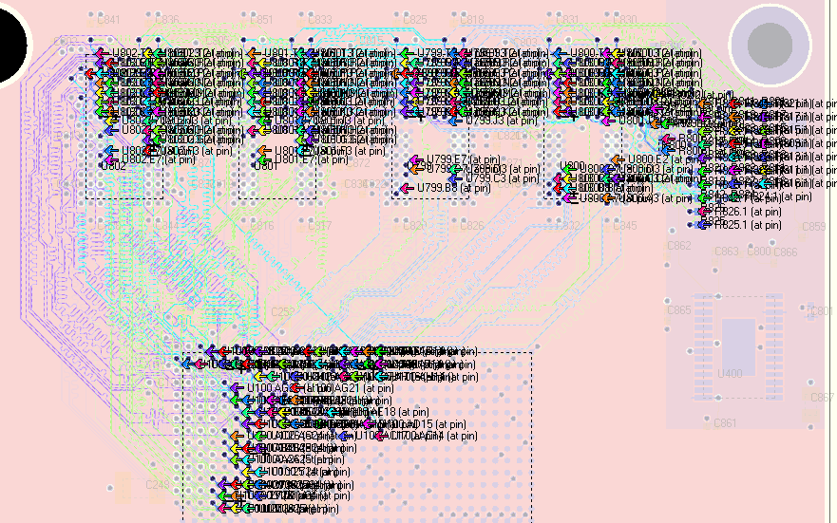
Geometrical coupling thresholds
Area fills = Off
Thresholds | Time,s | #Agg | Crosstalk, V*ps
D=15, L=500, HV=1 | 5 | 1 | 13.8
D=100, L=500, HV=1 | 45 | 6 | 31
D=500, L=500, HV=1 | 128 | 8 | 32.5
D=100, L=500, HV=10 | 133 | 14 | 38.8
D=100, L=100, HV=10 | 212 | 23 | 40
D=300, L=100, HV=10 | 927 | 26 | 38.1
D=500, L=1, HV=10 | 2073 | 62 | 38.1
Area fills = On
Thresholds | Time,s | #Agg | Crosstalk, V*ps
D=15, L=500, HV=1 | 16 | 1 | 15.6
D=100, L=500, HV=1 | 163 | 6 | 10.4
D=500, L=500, HV=1 | 975 | 8 | 26.8
D=100, L=500, HV=10 | 858 | 15 | 13.6
D=100, L=100, HV=10 | 2420 | 28 | 17.6

Slide 10
Useful environment variables
HL_BATCH_ALL_WDB_WAVEFORMS=1
HL_CCT_IGNORE_IBIS_MODEL=1
HL_CCT_NETLIST=1

